Slide 1

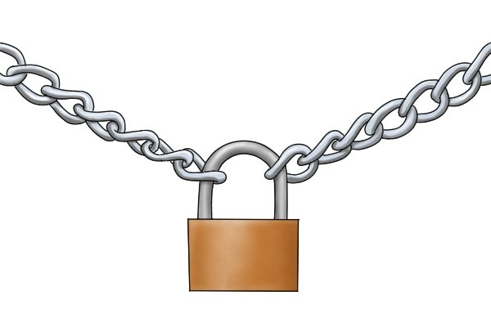
by
BLOCK CHAIN
NAME : PETER I MWANGI
REG. NO. :SCT321-C004-2079/2018
UNIT : RESEARCH SEMINAR

Slide 2





What comes to your mind block chain is mentioned ?
CRYPTOCURRENCY
CRYPTOGRAPHY
HASHING
Miners
ENCRYPTION
Smart contracts
Decentralization

Slide 3
Learning Objectives….
History of block chain
Introduction and definition of block chain and block chain technology
Components of block chain
Overview on how the block chain works
Opportunities presented by block chain technology
Applications of block chain and case studies
Emerging issues with block chain technology
Future trends in block chain
A Kenyan perspective on block chain technology
QUESTIONS
&
COMMENTS

Slide 4
History of block chain.
In 2008, the emergence of the blockchain as the foundation of the first ever decentralized crypto-currency, Bitcoin by pseudonymous Satoshi Nakamoto, presented a successful implementation and a spring board to other inventions.
In 1991 (Haber & Stornetta, 1991) worked on a cryptographically secured chain of blocks, where they wanted to implement a system where documents timestamps could not be tampered with.
An year later they incorporated merkle trees to the design, which improved its efficiency by allowing several document certificates to be collected in one block.
“A hash tree or Merkle tree is a tree in which every leaf node is labelled with the hash of a data block, and every non-leaf node is labelled with the cryptographic hash of the labels of its child nodes.”

Slide 5

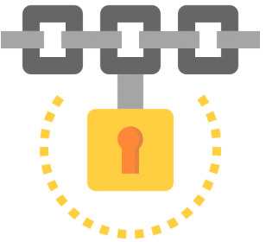
Introduction to blockchain.
What is Blockchain
A blockchain is essentially a distributed database of records or public ledger of all transactions or digital events that have been executed and shared among participating parties
Each transaction in the public ledger is verified by consensus of a majority of the participants in the system. And, once entered, information can never be erased.
A block can be thought of as the container for data. bitcoin blockchain, each block contains data (such as bitcoin transactions), Block Header, Block Identifies, and Merkle Trees.
This is a cryptographic hash in the block header of each block, which ties the blocks together chronologically in a chain.

Slide 6

Components of block chain

Slide 7
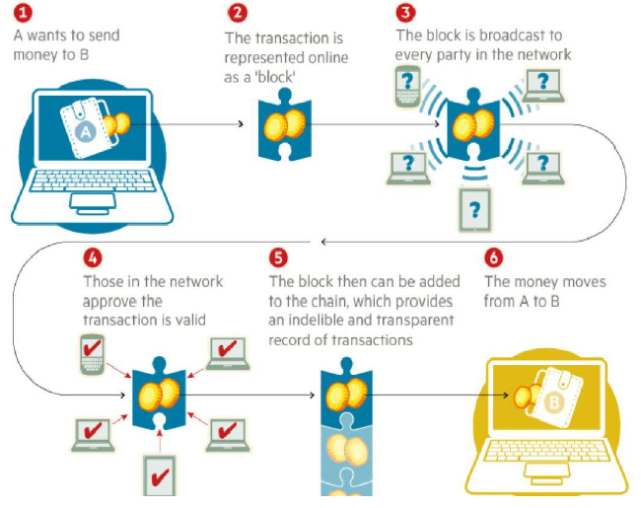
Overview on how the block chain works

Slide 8
Overview on how the block chain works
When a block stores new data it is stored into a block chain. As the name suggests, block chain consists of many blocks strung together. However, for a block to be added to the block chain four things must happen.
They are:
    A transaction must occur.
    The transaction must be verified.
    The transaction must be stored in a block.
    That block must be given a hash.
Once a block is added to the block chain, it becomes publicly available for anyone to view. You have access to transaction data, along with information about when, where, and by who the block was added to the block chain.

Slide 9
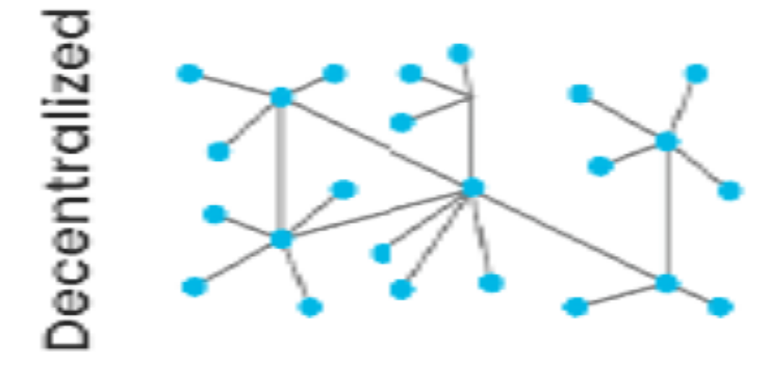
Pillars of Block chain Technology
Decentralization
A decentralized network gives you an opportunity to interact with your friend directly without going through a third party. This is the main ideology in block chain. A decentralized system’s information is not stored by one single entity. Everyone in the network owns the information (Don & Alex, 2019).

Slide 10
Opportunities presented by block chain technology

Slide 11
Applications of block chain and case studies

Slide 12
Emerging issues with block chain technology

Slide 13
Title and Content Layout with SmartArt

Slide 14
Title and Content Layout with SmartArt

Slide 15
Title and Content Layout with SmartArt

Slide 16
Title and Content Layout with SmartArt

Slide 17
Title and Content Layout with SmartArt

Slide 18
Title and Content Layout with SmartArt

Slide 19
Title and Content Layout with SmartArt

Slide 20
Title and Content Layout with SmartArt

Slide 21
Title and Content Layout with SmartArt

